Slide 1
Regular Expressions (Regexes)

Slide 2
Overview
What are regular expressions (regexes)
Regex Grammar
character classes [..]
metacharacters \ $ ^ . ?
quantifiers: * + ?
Python and Regexes
re.search
re.findall
re.sub
Regex Fun

Slide 3
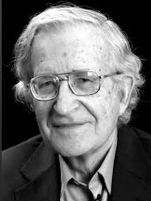
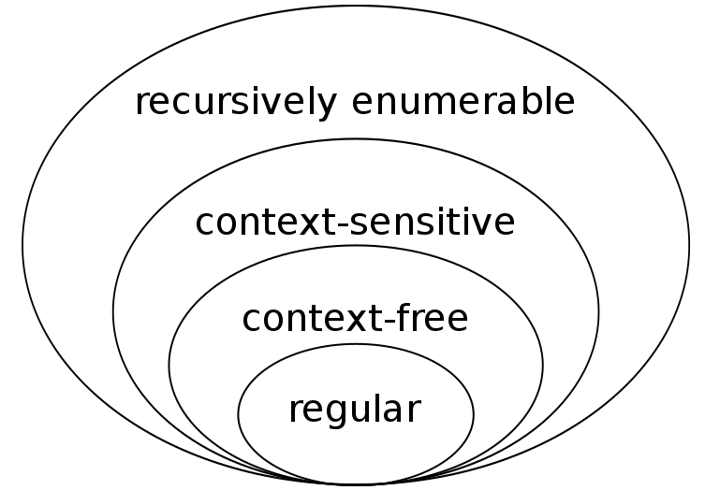
Regular Expressions (Regexes)
A technology for parsing text and finding complex patterns using a simple 'regular' language
In the 1950's, the linguist Noam Chomsky came up with a a categorization for languages of increasing complexity based on their grammar rules
basis for human languages
basis for programming languages
basis for regular expressions

Slide 4
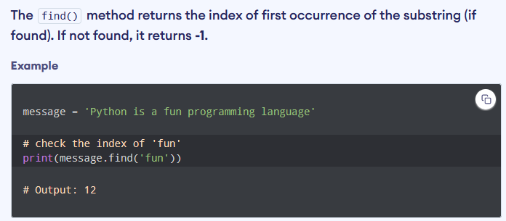
Regexes go way beyond simple string matching
Regexes can do MORE!

Slide 5
Regex
A regex defines a search pattern for strings.
The search pattern can be anything from a simple character, a fixed string or a complex expression containing special characters describing the pattern.
The pattern defined by the regex may match one or several times or not at all for a given string.
Regular expressions can be used to search, edit and manipulate text.

Slide 6
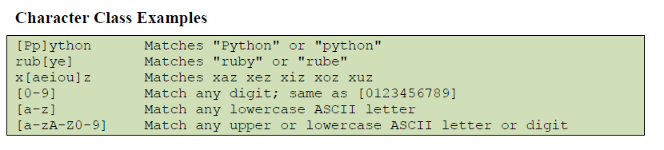
Character Classes
Defined by characters inside square brackets
http://www.regexpal.com

Slide 7
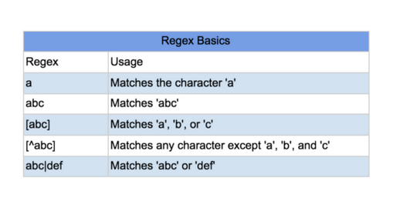
Characters and the character class

Slide 8
Metacharacters

Slide 9
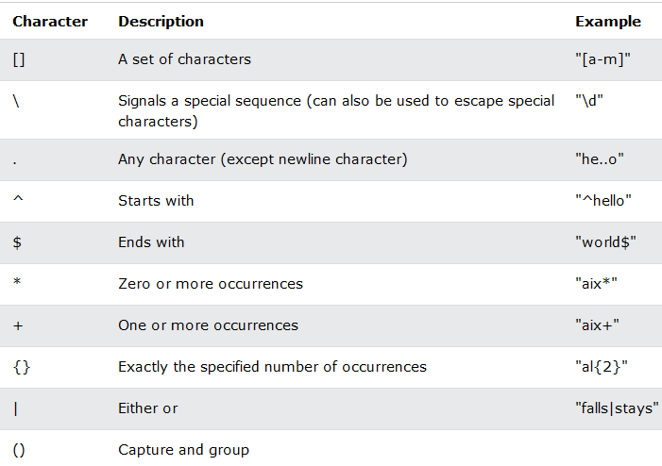
Metacharacters – characters with special meaning

Slide 10
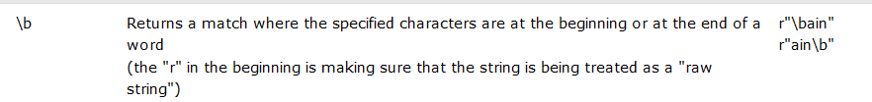
Special Sequences with \

Slide 11
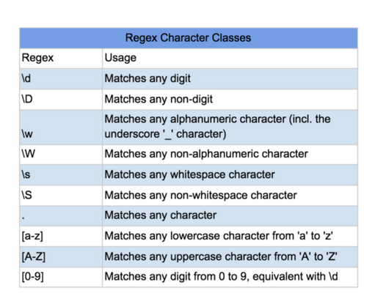
more examples..

Slide 12
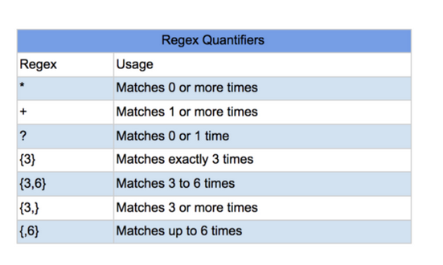
Quantifiers

Slide 13
Python and Regexes

Slide 14
Python Regex
import re # import the regex library
txt = "Rollo scored 99 on his midterm exam"
regex = r"\d+"
match = re.search(regex, txt)
if match:
print ("Found a match")
Python uses "\" to escape characters in a Python strings (e.g. \n \t)
Use the 'r' prefix to specify a raw string (not a Python string) so that '\' does not get interpreted as a Python escape character.
see: w3 schools tutorial; https://www.w3schools.com/python/

Slide 15
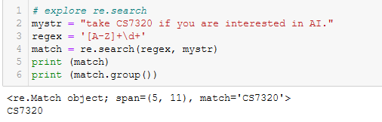
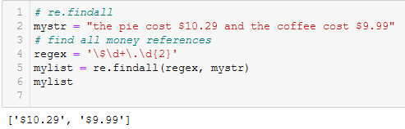
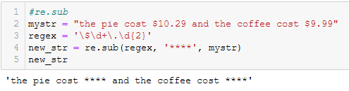
Regex Functions
re.search
re.findall
re.sub

Slide 16
Grouping
We often want to extract pieces of a larger phrase
txt = "News reports said that Rollo sold watermelons to Ralph"
We want to find out who sold what to whom.
regex = r"\w+ sold \w+ to \w+"
Put parens (..) around parts of the regex we want
regex = r"(\w+) sold (\w+) to (\w+)"
match = re.search(txt, regex)
print (match.group(1), match.group(2),match.group(3) )

Slide 17
Grouping and Back References (\1 \2 \3 ...)
Often when you identify a group, you may want to see if that group value is repeated in the text
We can use \1 to match the first group, \2 to match second group ..
Example: we want to if the same person bought and then sold the same stock.
s = "The news said Rollo bought NVDA and then Rollo sold NVDA the next day."
regex = r"(\w+) bought (\w+).* \1 sold \2"
match = re.search(regex, s)
print (match.group(1), match.group(2) )
>> Rollo NVDA

Slide 18
Greedy vs. Lazy Matching

Slide 19
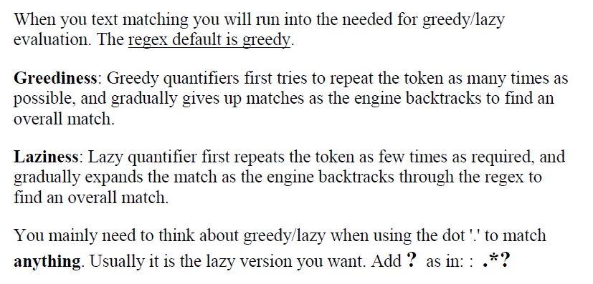
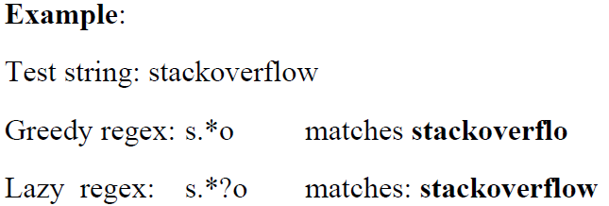
Greedy vs Lazy

Slide 20
Summary
Regexes are based on Regular Languages (from Chomsky)
Used to identify complex strings in text
They are FAST!
Character classes, Metacharacters, Quantifiers
Greedy vs Lazy Matching
Python functions
re.search
re.findall
re.sub

Slide 21
Using findall and groups

Slide 22
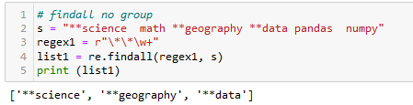
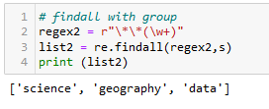
re.findall and Groups

